Slide 1
Programming 101 Day 2
Comparisons, Conditions and Loops

Slide 2
Outline
Comparisons
Conditions
Loops

Slide 3
Conditions & Comparisons

Slide 4
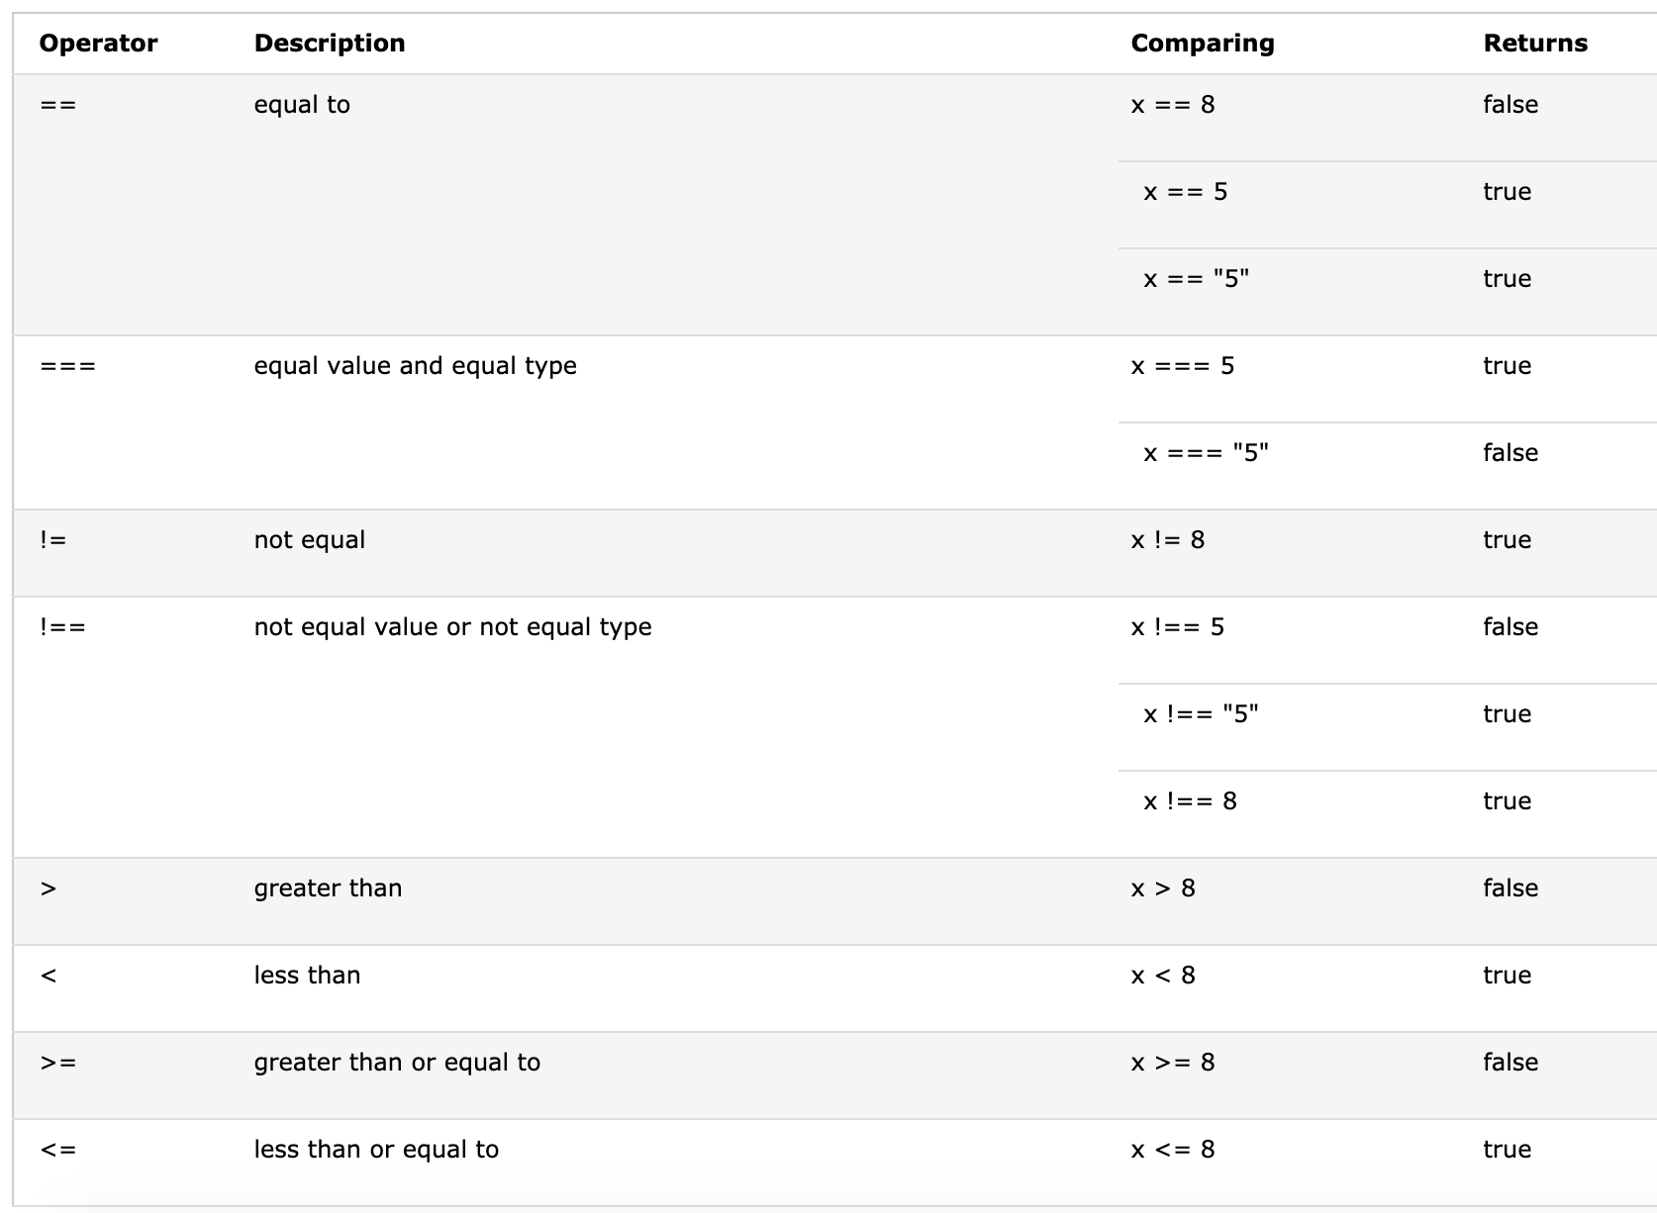
Comparison Operators

Slide 5
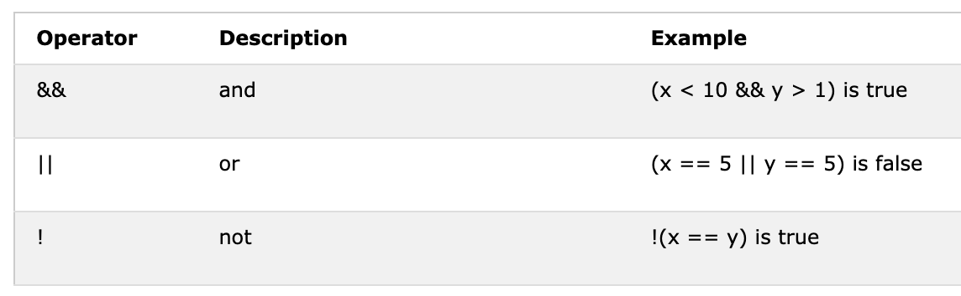
Logical Operators

Slide 6
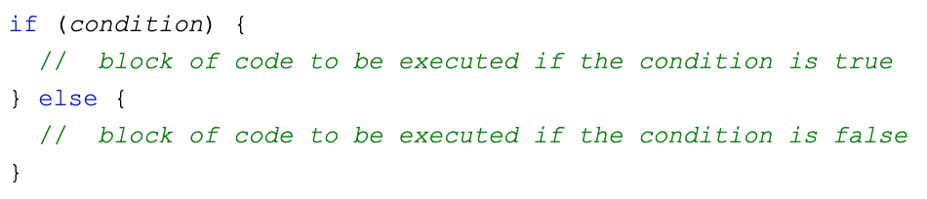
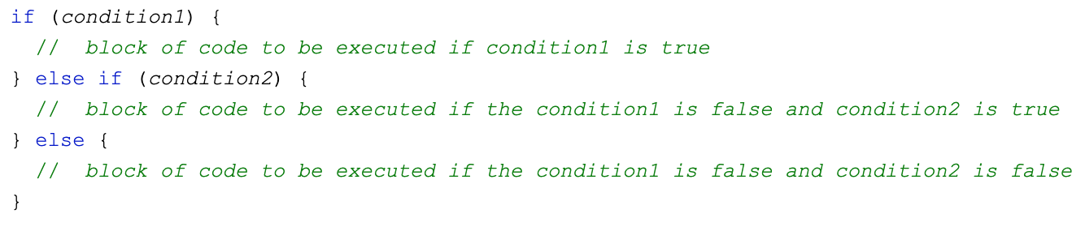
IF-ELSE

Slide 7
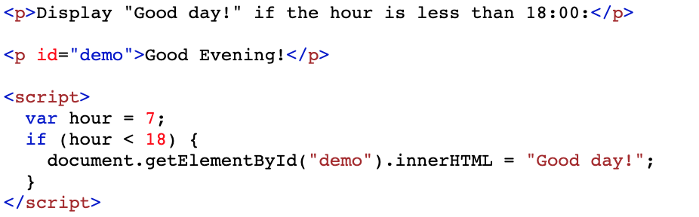
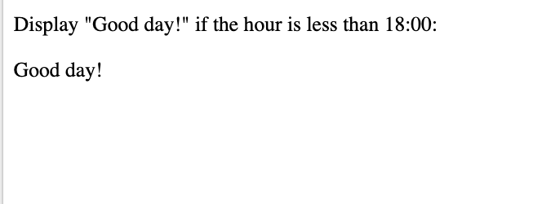
Example 1 (if)

Slide 8
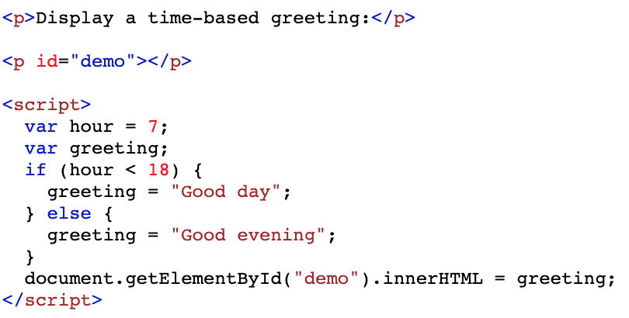
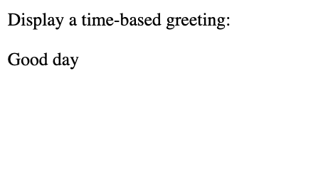
Example 2 (if-else)

Slide 9
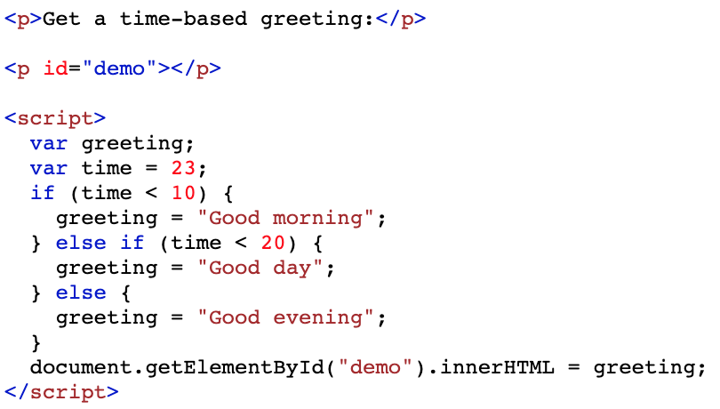
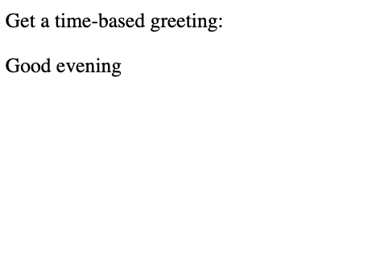
Example 3 (if - else if - else)

Slide 10
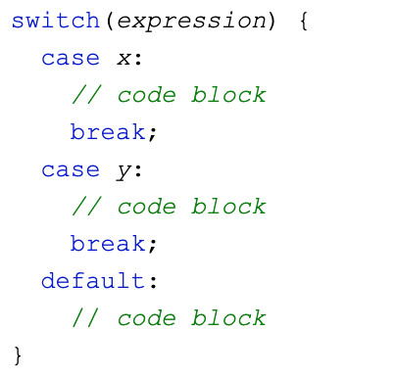
Comparison with Switch

Slide 11
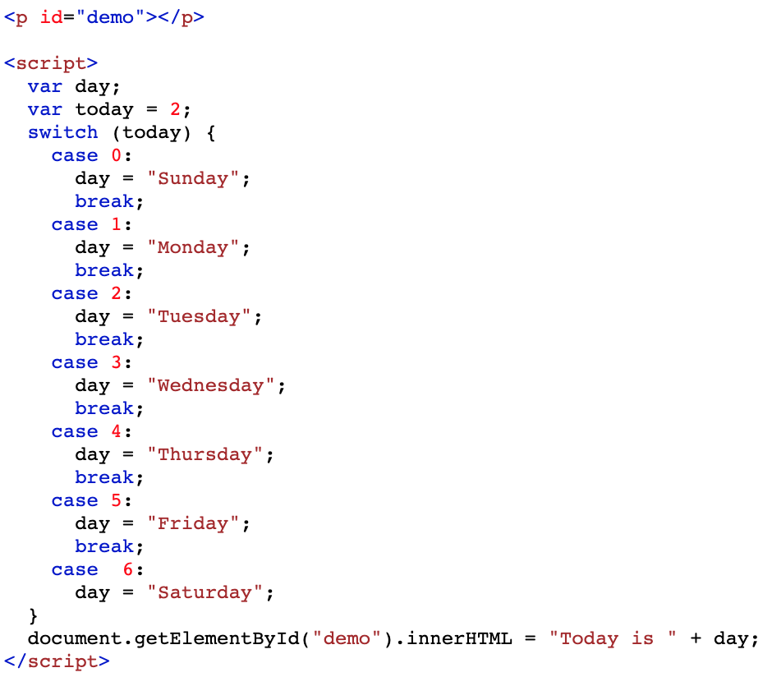
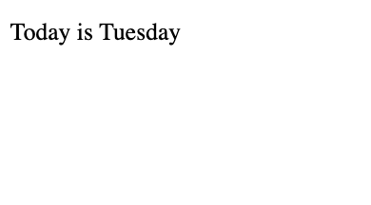
Example

Slide 12
Loops

Slide 13
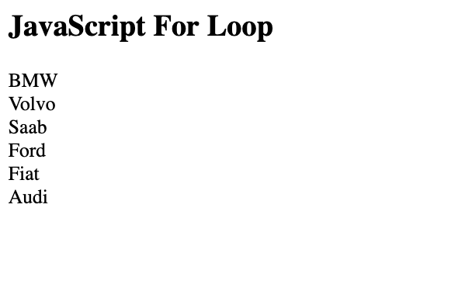
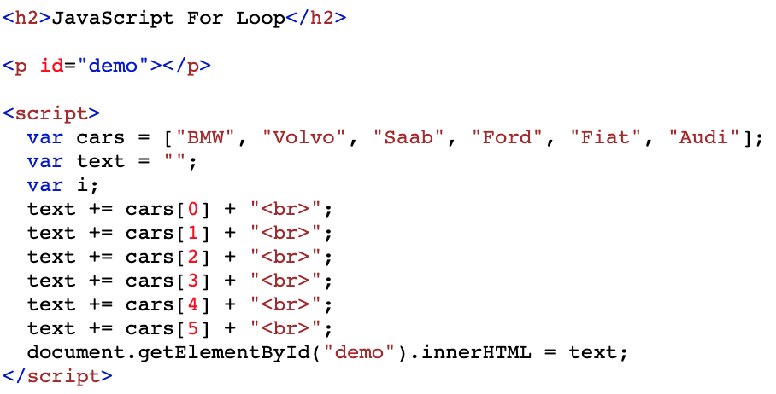
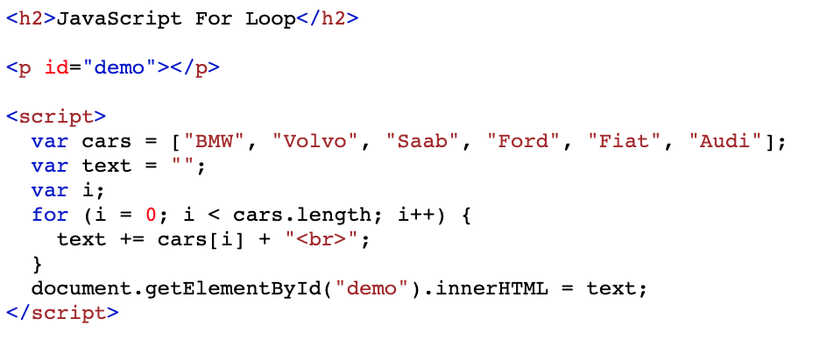
Why to use loops?

Slide 14
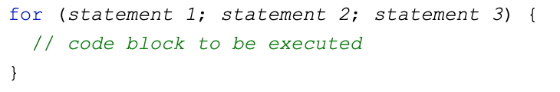
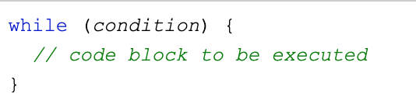
For & While

Slide 15
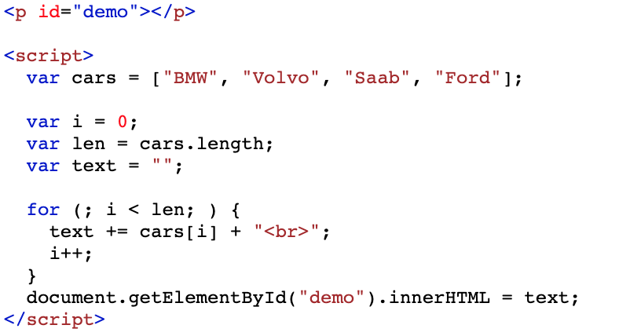
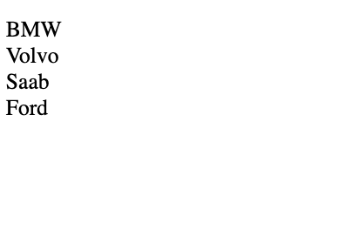
For loop

Slide 16
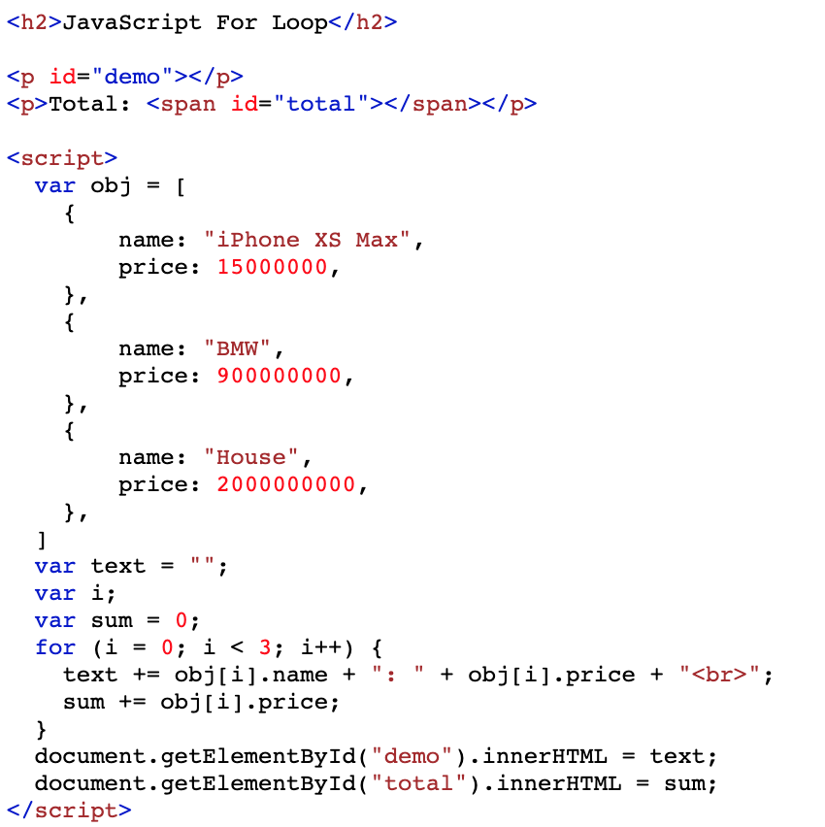
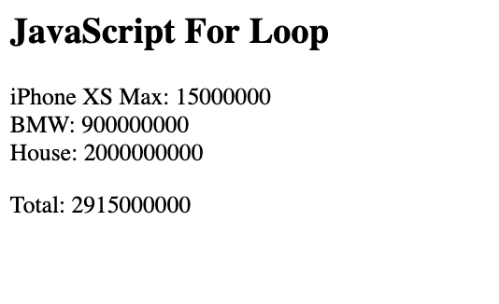
For loop

Slide 17
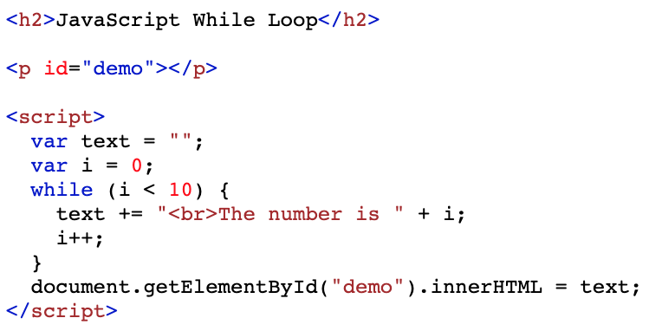
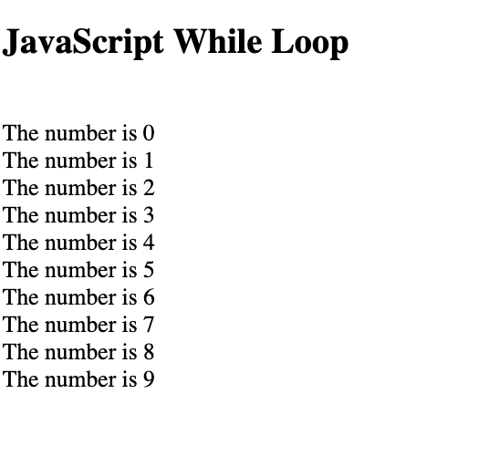
While loop

Slide 18
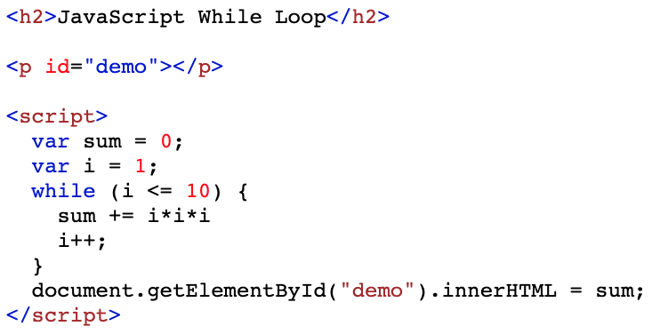
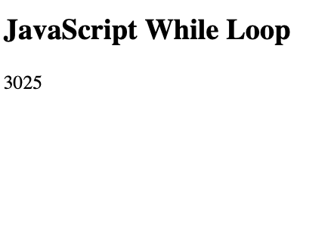
While loop

Slide 19
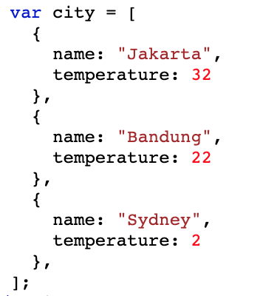
Practice 1
Create array of city and its temperature
Show the category with these following rules:
temperature > 27 → Hot
15 < temperature <= 27 → Fair
Temperature <= 15 → Cold

Slide 20
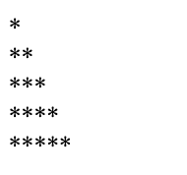
Practice 2
Create variable line = 5
Use loops to show each line like the image!

Slide 21
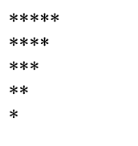
Practice 3
Create variable line = 5
Use loops to show each line like the image!

Slide 22
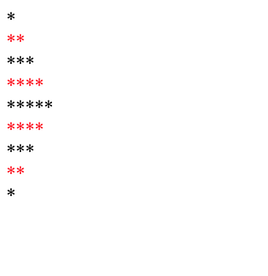
Keep Practicing!
Create variable line = 9
Use loops to show each line like the image!

Slide 23
Today’s lesson:
Comparisons
Conditions
For & while loops
Basic Algorithm

Slide 24
“Any fool can know. The point is to understand”
- Albert Einstein

